Slide 1
HK International Schools and their Surrounding Venues
To Flag or Not To Flag

Slide 2
Introduction
Choosing schools often is a huge decision for parents, especially for weary-eyed parents hoping to have their kids stay in school and study as far away from 'attractions' as possible. There will be a couple of assumptions:
These parents are in Hong Kong and are placing kids into International Secondary Schools (kids have ability to roam free either during lunch or immediately after school). Hence not considering primary schools or kindergartens.
Some stereotypical attraction-joints that parents are keen to avoid include arcades, gaming-areas, shopping malls, bars, clubs etc. Let this list not be exhaustive, but also be known as "the list". 3) The consideration would be "walking distance" from schools, definted as less than 200 meters.

Slide 3
Introduction
By no means does this study aim to define what is the best school just by highlighting what attractions there are, but it aims to highlight the different or similarity on shops are around schools. If there are any venues that are mentioned in "the list" it was also be flagged.
THE LIST:
Gaming Arcade
Bars
Clubs
Entertainment Joins
Cinemas
Shopping Malls

Slide 4
Data Section
Mainly two sources:
Foursquare API
HK Government International Schools CSV File

Slide 5
Methodology
The longitude and latitude data are provided by a CSV by the government. However it uses a Degree, Minutes and Seconds for Latitude and Longitude, so there needs to be a conversion to Decimal Degree Latitude and Longitude. So this would require some data cleaning.
Then after isolating and getting the correct lat long data form the office source, this would then be used to query foursquare API for the nearby venues within a limit of 200 meters.
After the result is stored and queries, we will run a kmeans to seperate the different clusters and see if there are different / similarities of these cluster-venues around the schools.

Slide 6
Data Section
24 International Schools
64 Venues Returned within 200 m of the Schools
5 Clusters
All Within Hong Kong

Slide 7
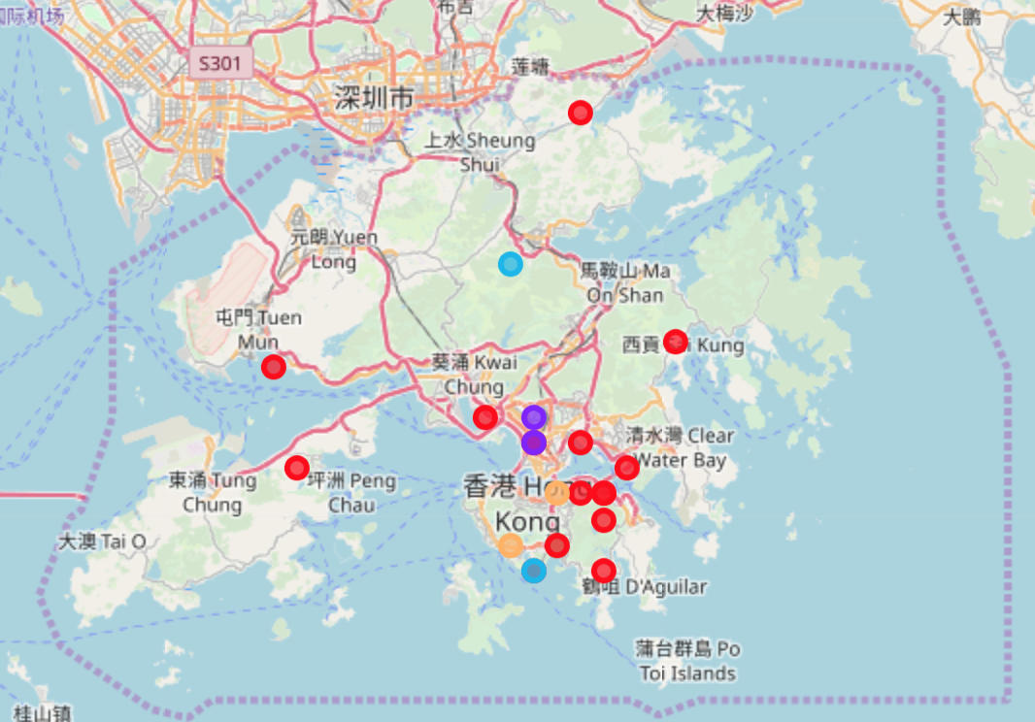
Map: Generated by Folium

Slide 8
Conclusion
The shop venues were split into 5 clusters and only 64 different shops were queried from Foursquare. The small sample size could have been because of the limited 200m limitation of the foursquare api query and also possibility the limited number of venues around those schools that are in foursquare's database. This also caused a significant repitition of venues sample set because it was included as a top 10 even though its possible they were a value of "0".
Despite splitting the shop levels into 5 different clusters. From the map observation, overwhelmingly clusters 0, which make up the majority inside the cluster group (16 were in this cluster), and most of them are around the "edges" or borders of Hong Kong.
In light of this, there appears to be no venues that are close to these sample set of international schools that were in "the list" of venues that needs to be flagged (gaming arcades etc). Weary eyes parents should discount this factor and choose schools based on other factors and not include geographical factors like surrounding-attractions.

